Slide 1

EXCEL MODULE 5 – CHARTING
Enhancing Your Data Analysis Skills Pathway
2023

Slide 2
Agenda
The Insert tab and inserting charts
Improving Excel’s defaults, 1 – labels and axes
Improving Excel’s defaults, 2 – title and palette
Do’s and don’t s of charting
Exercise

Slide 3
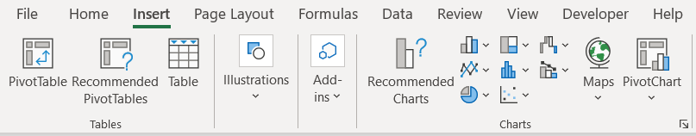
The INSERT tab and inserting charts
1
Select the data range you want to chart.
2
Click the Insert tab.
3
Choose the type of chart you want to use.
4
Alternatively, create a chart in the same worksheet with ALT + F1.
Notes:
An Excel spreadsheet is a large flexible grid that is used to store, modify and analyse information.
This data is typically numerical, but can also be things like text, dates, chart objects etc.
In Excel, data is stored in a worksheet, which is made up of rows (1) and columns (2). The intersection of a row and column is called a cell (3), and can contain may types of data.

Slide 4
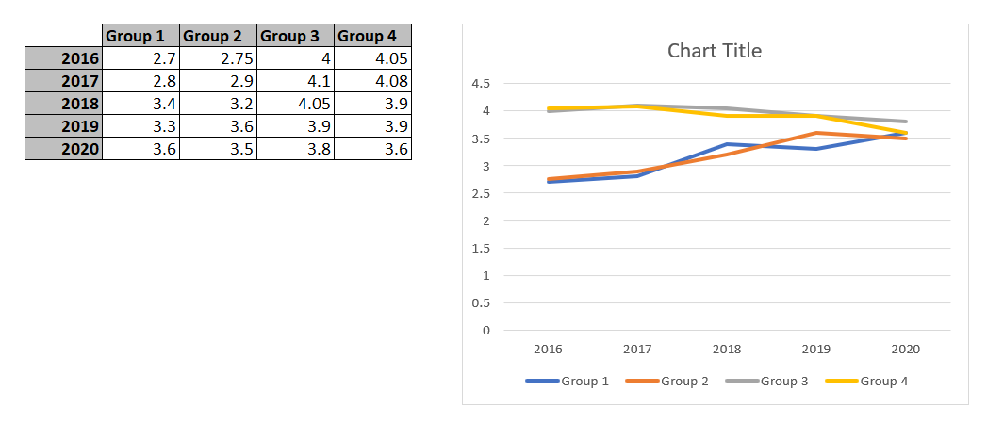
Improving Excel’s defaults, 1: labels and Axes
Here, the default labels provided by Excel are too far away from the data line.
We can solve this by labelling individual data points.

Slide 5
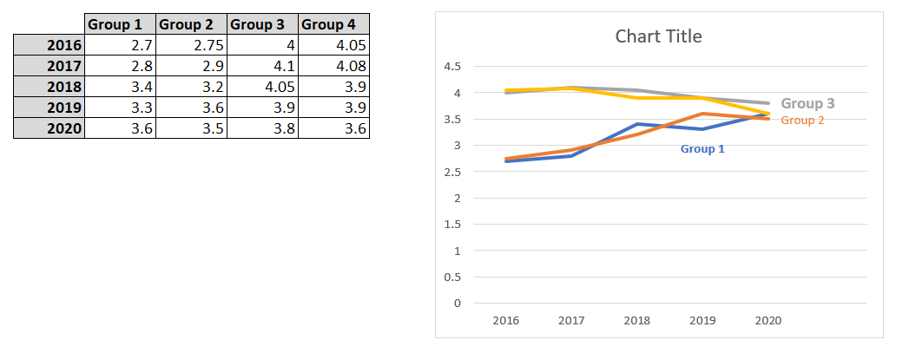
Improving Excel’s defaults, 1: labels and Axes
Placing and colour makes the connection far clearer.

Slide 6
Improving Excel’s defaults, 2: title and Palette
The default chart title tells us nothing about the chart. We can click on it and manually write in the title, or …
Notes:
Column: Vertical series of adjacent cells from top to bottom
Row: Horizontal series of cells from left to right
Cell: Intersection of a row and column
Active Cell: Cell that is currently selected
Cell range: Series or block of adjacent cells
This range here would be indicated as cell E5 to G7. So from the top left hand cell to the bottom righthand cell.

Slide 7
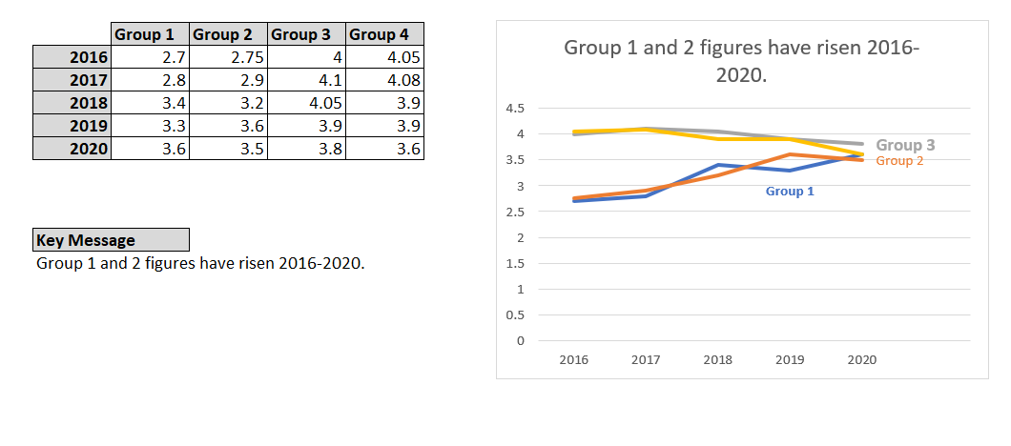
Improving Excel’s defaults, 2: title and Palette
… use a formula. This method is more flexible and allows the chart to be re-used.
Notes:
Column: Vertical series of adjacent cells from top to bottom
Row: Horizontal series of cells from left to right
Cell: Intersection of a row and column
Active Cell: Cell that is currently selected
Cell range: Series or block of adjacent cells
This range here would be indicated as cell E5 to G7. So from the top left hand cell to the bottom righthand cell.

Slide 8
Dos and Don’ts of charting
DO
DON’T
Keep the number of variables in your chart manageable. If necessary, make 2 charts.
Use the outdated Excel 3D templates.
Keep key and labels close to the data so the eye does not have to ‘roam’.
Assume the suggested chart is always the right one for your data.
Make titles explain the graph and bring out the key point.
Notes:
1: Ribbon Interface
Displays tab commands organized into groups. If you click the different tabs, you will see the commands change. Notice that some of the commands might be grayed out. This is because those commands are only usable in certain situations. The File tab, which opens Backstage view, is also included here.
2: Tabs
Groups of similar commands are organized under tab names. Click a tab to view the commands in the ribbon.
3: Quick Access Toolbar
As the name implies, the Quick Access toolbar gives you quick access to frequently used commands. This toolbar is completely customizable and can be positioned above or below the ribbon commands.
4: Name Box
Every cell has a name in the format “ColumnRow”. The name of the currently selected cell, called the active cell, is shown in the Name Box. In the sample image, the active cell is A1.
5: Formula Bar
The Formula Bar allows you to enter data in a cell. Data can be alphanumeric, pictures, symbols, or (as the name suggests) formulae.
6: Working Area
The data contained in the file will be shown here.
7: Worksheet Tabs
Every Excel file is properly referred to as a workbook. A workbook can contain one or more worksheets, just like an accounting ledger can contain one or more pages. Click these tabs to switch between the different worksheets.
8: Status Bar
This bar is used to display information about the workbook. Any running calculations will be shown here. There are also some zoom and view commands here.
9: Scroll Bars
As you grow more accustomed to working with Excel, you may begin to work on larger files. When all of the information in a worksheet will not fit on the screen, you can use these scroll bars to scroll horizontally or vertically through the data.

